Slide 1
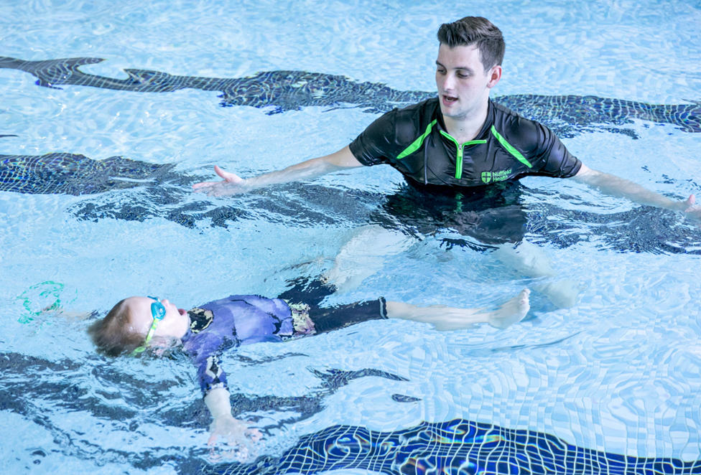
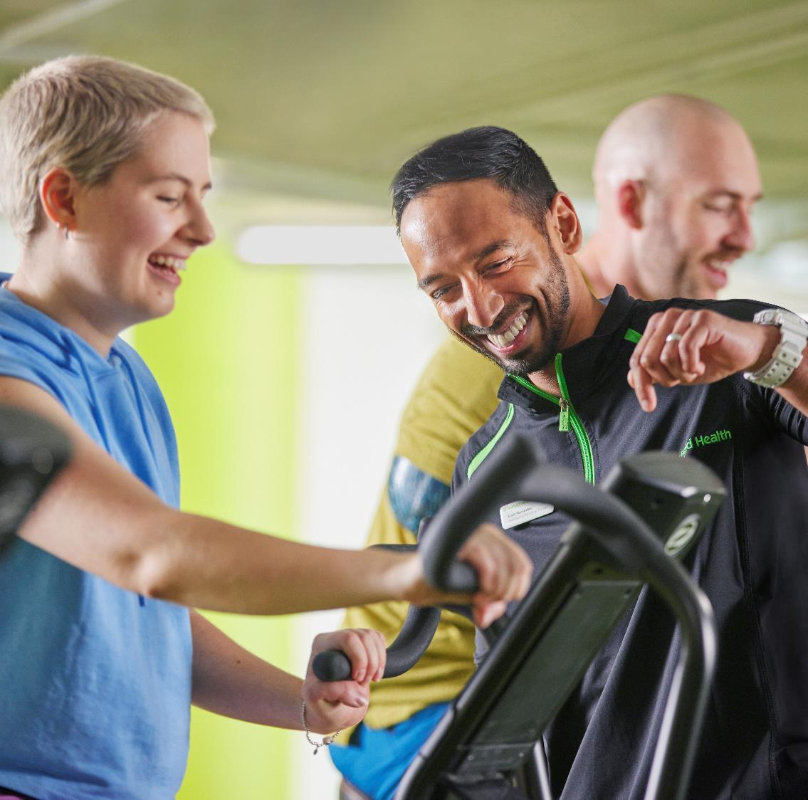

Water Safety
School presentation

Slide 2
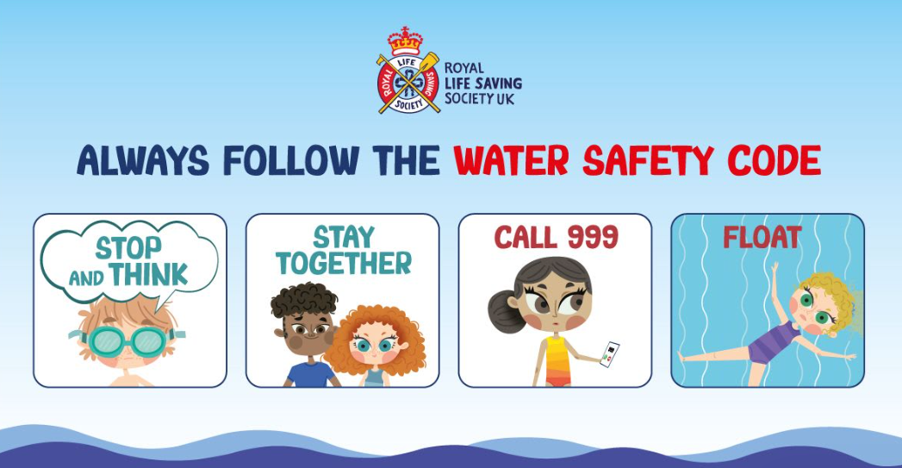


Slide 3
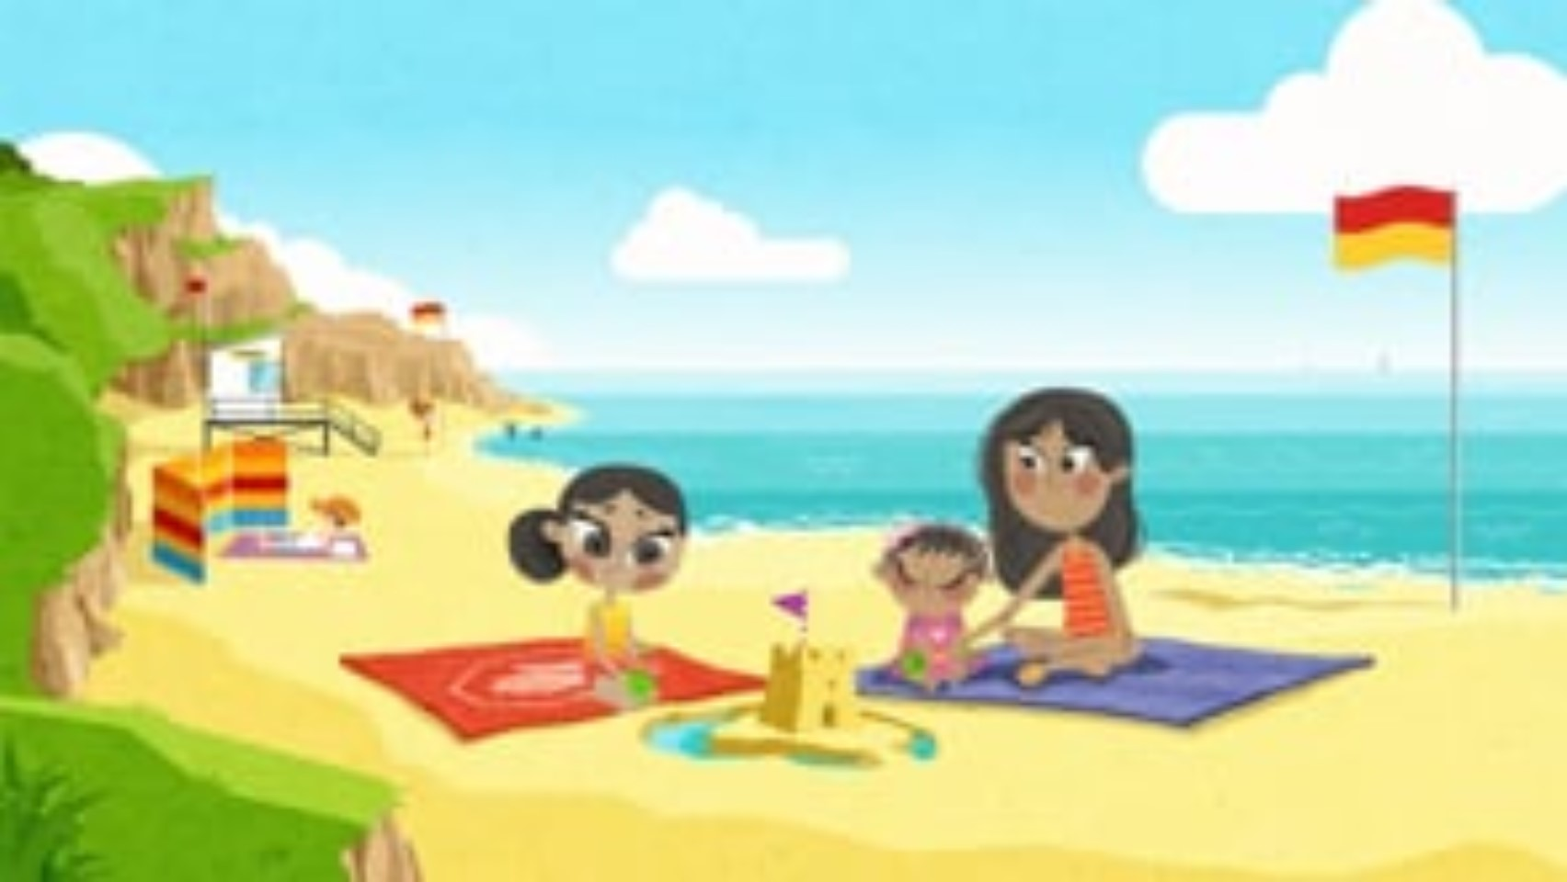

Slide 4
Video quiz
1. If your friend goes into the water, do you follow them in?
2. If someone in the water needs help, do you go into the water to help them?

Slide 5

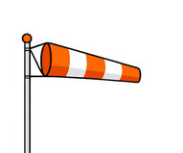



Know your flags
  Red-and-Yellow beach flag
Lifeguard patrolled area for swimming and body boarding zone
  Black & White chequered flag
Surfboard and other water sports area
  Red Beach Flag
Dangerous conditions: Do not enter the water
  Orange Windsock
No inflatables to be used in the water- indicated high winds

Slide 6
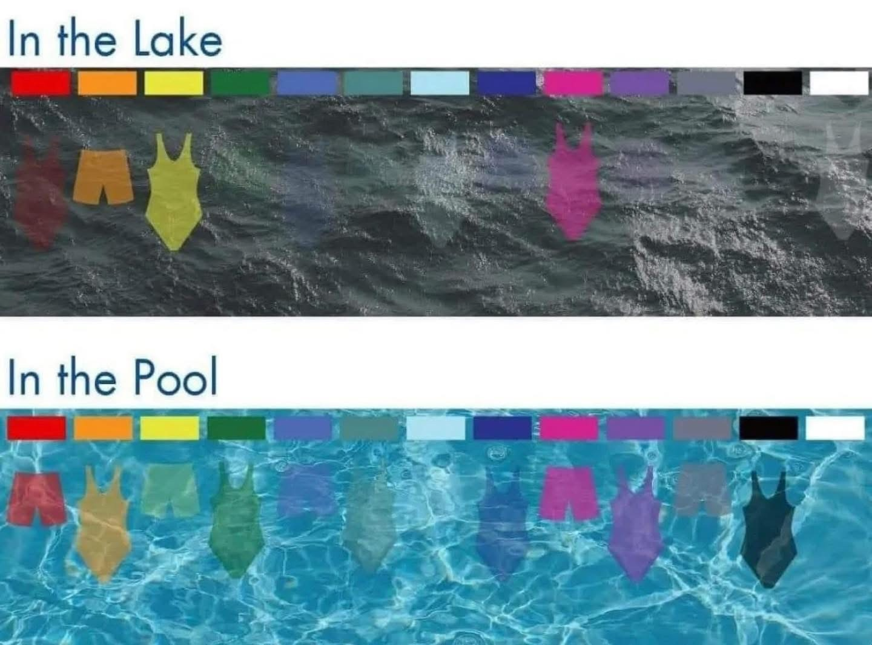
See why the colour of our swimwear is important?
Why do you think Yellow is a good colour to wear in a lake?
Why is white a bad choice to wear in a pool?

Slide 7
Activity time
Wordsearch & colouring in
Match the flag to it’s meaning
Save a friend- put the Water Safety code into practise
  Equipment- pool noodles, floats, football

