Slide 1
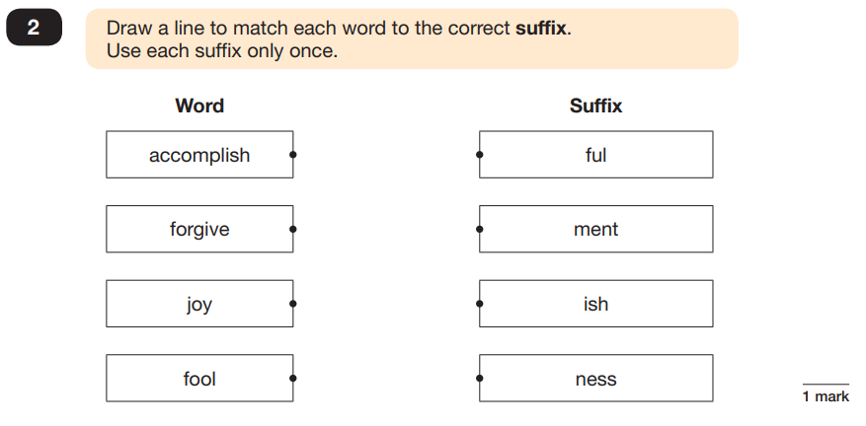
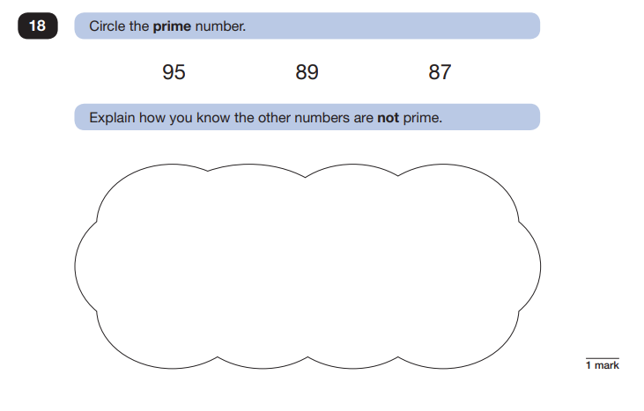

Welcome, please have a go…

Slide 2

SATs Information Meeting
Tuesday 13th February 2024

Slide 3
Agenda
What are SATs ?
When are the tests taking place?
What are children tested on ?
How are school preparing the children?
How can parents help?
Questions

Slide 4
What are SATs?
SATS – Standard Assessment Tests
National Tests taken by all children in Local Authority schools in England.
Method of comparing the achievement of children in a school against national standards

Slide 5
When are this year’s tests?
Monday 13 May 2024 | Grammar, Punctuation & Spelling - Paper 1 Grammar, Punctuation & Spelling - Paper 2
Tuesday 14 May 2024 | English Reading
Wednesday 15 May 2024 | Maths Paper 1 (Arithmetic) Maths Paper 2 (Reasoning)
Thursday 16 May 2024 | Maths Paper 3 (Reasoning)
Similar to recent years, writing will be teacher assessed internally. The assessment has a greater emphasis on composition and grammar, punctuation and spellings.
Access arrangements

Slide 6
English Tests
Spelling Punctuation And Grammar
The SPaG test consists of two papers.
The first paper is a 20 word spelling test.
The second paper consists of grammar and punctuation questions and lasts 45 minutes.
A total of 70 marks are available.
Questions are designed to assess the understanding of primary school spelling rules.
During the SPaG paper, children have a range of multiple choice questions which cover areas such as word classes, tenses, conjunctions, sentence structure and use of punctuation.

Slide 7
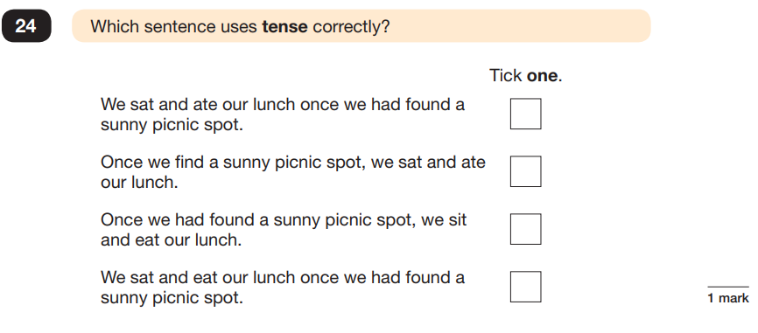
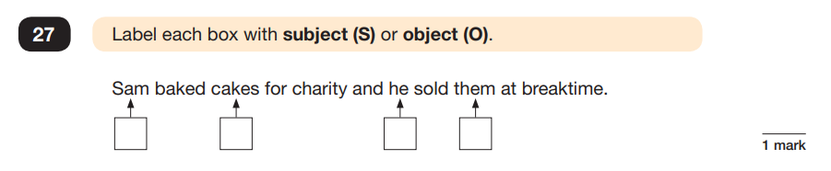

Slide 8
How to help your child with SPaG?
When reading with your child discuss the following:
-Word classes
-Synonyms and antonyms of words
-Tenses within sentences
-Can you find me a relative clause within the text?
The more your child is exposed to a range of reading, the more familiar they will become with different grammar techniques.

Slide 9
English Tests
READING
The reading test consists of a single test paper with three unrelated reading texts.
Children are given 60 minutes in total, which includes reading the texts and answering the questions.
A total of 50 marks are available.
Questions are designed to assess the comprehension and understanding of a child’s reading.
Some questions are multiple choice or selected response; others require short answers and some require an extended response or explanation.

Slide 10
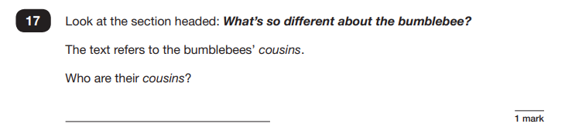
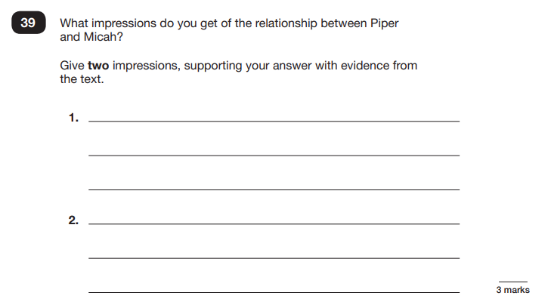

Slide 11
How to help your child with reading?
Listening to your child read can take many forms.
First and foremost, focus developing an enjoyment and love of reading.
Enjoy stories together – reading stories to your child at KS1 and KS2 is as equally important, as listening to your child read.
Read a little at a time but often, rather than rarely but for long periods of time!
Talk about the story before, during and afterwards – discuss the plot, the characters, their feelings and actions, how it makes you feel, predict what will happen and encourage your child to have their own opinions.
Look up definitions of words together – you could use a dictionary, the Internet or an app on a phone or tablet.
All reading is valuable – it doesn’t have to be just stories. Reading can involve anything: fiction, non-fiction, poetry, newspapers, magazines, football programmes and TV guides.

Slide 12
Maths SATS paper
Children will sit three tests: paper 1, paper 2 and paper 3.
Paper 1 is for arithmetic, lasting for 30 minutes, covering calculation methods for all operations, including use of fractions, percentages and decimals.
Questions gradually increase in difficulty. Not all children will be expected to access some of the more difficult questions later in the paper.
Papers 2 and 3 cover problem solving and reasoning, each lasting for 40 minutes.
Pupils will still require calculation skills but will need to answer questions in context and decide what is required to find a solution.

Slide 13
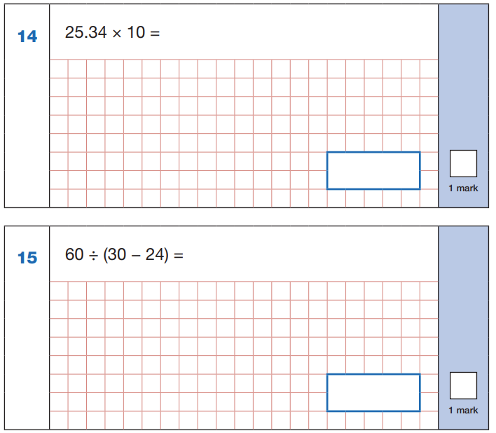
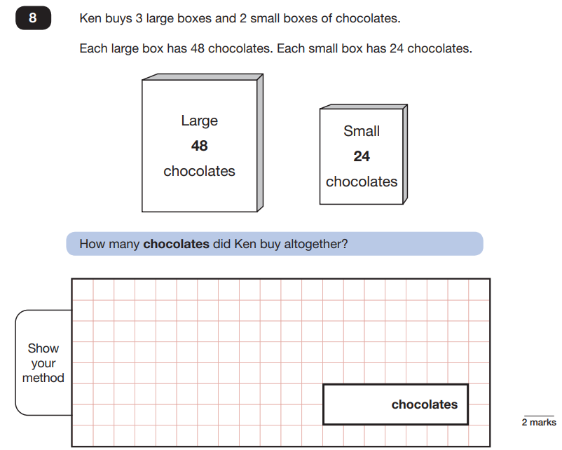
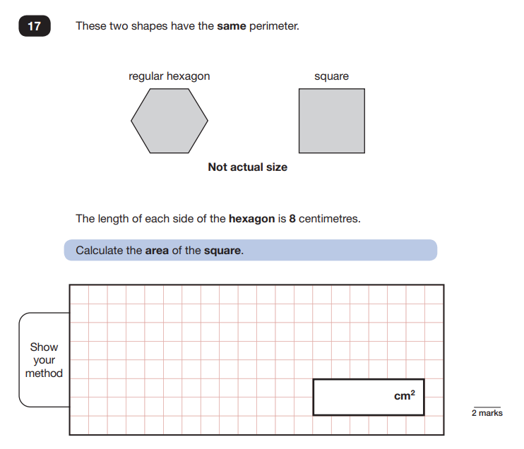

Slide 14
How to help your child with Maths?
Play times tables games- Children need to know up to 12 times table as well as multiplying and dividing by 10, 100 and 1000.
Play mental maths games, including counting in different amounts, forwards and backwards.
Encourage opportunities for telling the time/ looking at train/bus time tables.
Encourage opportunities for counting coins and money; finding amounts or calculating change when shopping.
Look for examples of 2D and 3D shapes around the home.
Identify, weigh or measure quantities and amounts in the kitchen or in recipes.
(g-kg/ ml-l/ cm/m/km)
Play games involving numbers or logic, such as dominoes, card games, darts, draughts and chess.

Slide 15
Assessment and feedback:
Tests are marked externally and send back to school.
What is meant by ‘scaled scores’?
It is planned that 100 will always represent the ‘national standard’.
Each pupil’s raw test score will therefore be converted into a score on the scale, either at, above or below 100.
Using the scaled score, the lowest a child can score is 80, with the highest being 120.
Greater depth: Standardised Score 110 - 120
Secure/National standard: Score 100 - 110
Below: Standardised Score near 80 - 99
In July you will receive:
-Scaled score in each tested subject.
-Confirmation of whether or not they attained the national standard.

Slide 16
Attendance
No authorised holidays!
Illness/accident – where possible children should come in to
take the test. Modifications can be made if necessary.
Lateness – please give us a call if you are running late, we may be able to delay the start of the test.

Slide 17
How is school preparing the children ?
Guidance on next steps to make work ‘even better’
Conferencing
Timed tasks and ‘mock’ tests
Emphasis on reasoning in Maths
A clear focus on developing vocabulary and inference skills in reading
Use of revision materials
Homework
Balanced curriculum
P.S.H.E.

Slide 18
Best way to prepare your child:
First and foremost, support and reassure your child that there is nothing to worry about and they should always just try their best. Praise and encourage!
Ensure your child has the best possible attendance at school (including arriving at 8:40am daily for small group work)
Support your child with any homework tasks
Reading, spelling and arithmetic (e.g. times tables) are always good to practise.
Talk to your child about what they have learnt at school and what book(s) they are reading (the character, the plot, their opinion).
Be aware of screen time.
Make sure your child has a good sleep and healthy breakfast every morning!
Balance work and play!

Slide 19
Useful Revision Materials
https://www.bbc.co.uk/bitesize/articles/zrybvk7
https://www.educationquizzes.com/ks2/english/
https://www.educationquizzes.com/ks2/maths/
www.bbc.co.uk/schools/ks2bitesize/
www.mymaths.co.uk
Times Tables Rockstars

Slide 20
Useful Revision Materials
CPG Key Stage 2 ‘Study Books’
Schofield and Simms Reading Comprehension and Grammar Guides
Rising Stars Revision Guides
Letts Revision Guides and sample papers

