Slide 1

Phonics workshop Reception
Monday 6th November 2023

Slide 2
What are we going to cover?
Terminology
Phase 2 and phase 3 sounds- examples and pronunciation
Different stages of learning to read
How you can support your child at home
Questions

Slide 3
End of year expectations:
Comprehension ELG
- Demonstrate understanding of what has been read to them by retelling stories and narratives using their own words and recently introduced vocabulary;
- Anticipate – where appropriate – key events in stories;
- Use and understand recently introduced vocabulary during discussions about stories, non-fiction, rhymes and poems and during role-play.
Word Reading ELG
- Say a sound for each letter in the alphabet and at least 10 digraphs;
- Read words consistent with their phonic knowledge by sound-blending;
- Read aloud simple sentences and books that are consistent with their phonic knowledge, including some common exception words
Writing ELG
- Write recognisable letters, most of which are correctly formed;
- Spell words by identifying sounds in them and representing the sounds with a letter or letters;
- Write simple phrases and sentences that can be read by others.

Slide 4
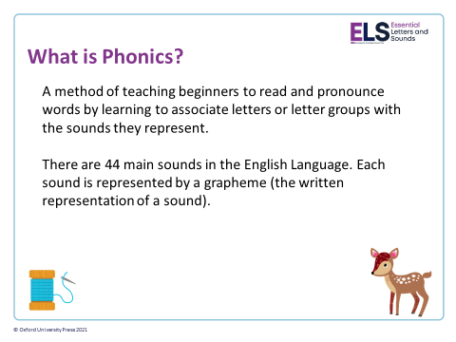

Slide 5
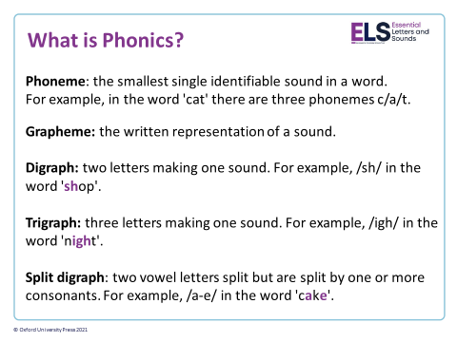
CVC word- consonant, vowel, consonant
E.G. cat/dog/sat/pin
CVCC word- consonant, vowel, consonant, consonant
E.G. best/ help
CCVC word- consonant, consonant, vowel, consonant
E.G. frog/drip

Slide 6
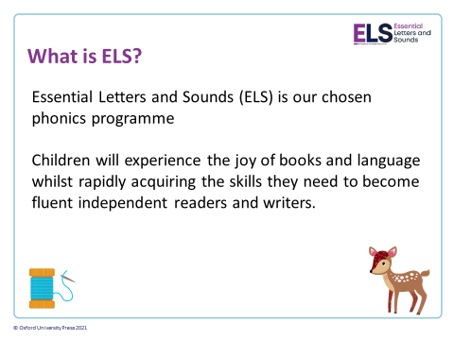
Notes:
We use phonemes and graphemes to teach children the code of our language.
English is one of the most challenging languages to learn as there are so many ways to spell the sounds of our language.
We teach children to decode words – by identifying each of the written sounds within the word before blending them together to read the word. This is a challenging process for children to learn and takes time to master. When they are able to decode and blend to....

Slide 7
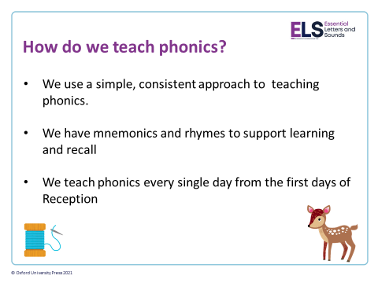
Notes:
Phonics teaches the link between the spoken sounds of our language and the written version of that sound – the code of our language.
As systematic synthetic phonics programme breaks this down into tiny steps for children to piece together which allows them to decode to read and then spell using the sound to spelling correspondences they have learnt.
We use a simple, consistent approach to teaching phonics.
Your child will experience the same classroom routines within each lesson which reduces cognitive load and maximises the chances of success.
All children are supported within the lesson to use their new phonic knowledge independently.
In every single ELS lesson, your child will make the direct application to reading.

Slide 8
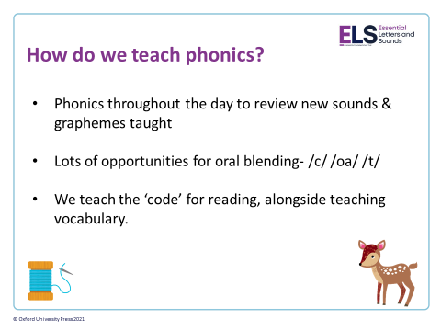

Slide 9
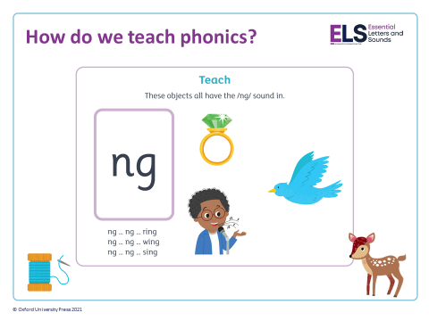
Phase 2 and 3 phonemes
We teach a new sound 4 days a week. The fifth day is seen as a review day.
We also teach and review ‘harder to read and spell’ words. These are words which are NOT decodable. We cannot sound these out, we have to learn to recognise these by sight.
Notes:
In ELS we do not ask children questions before we have taught them.
For example, when teaching a new sound, rather than asking children if they know any words with the sound in - we give the children 3 words that contain that sound. You can try this with your children at home.

Slide 10
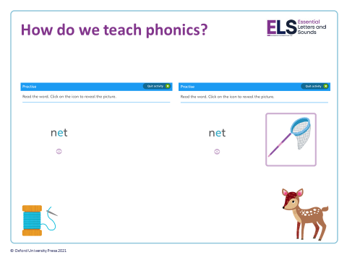
Notes:
The new teaching is always highlighted so that it is easy for all children to see where the new GPC they have been taught is located. First we say the new sound, then we find it in the word. Finally, we decode and blend. Children have as much or as little support as needed. We want every child to feel confident and successful at each step.

Slide 11

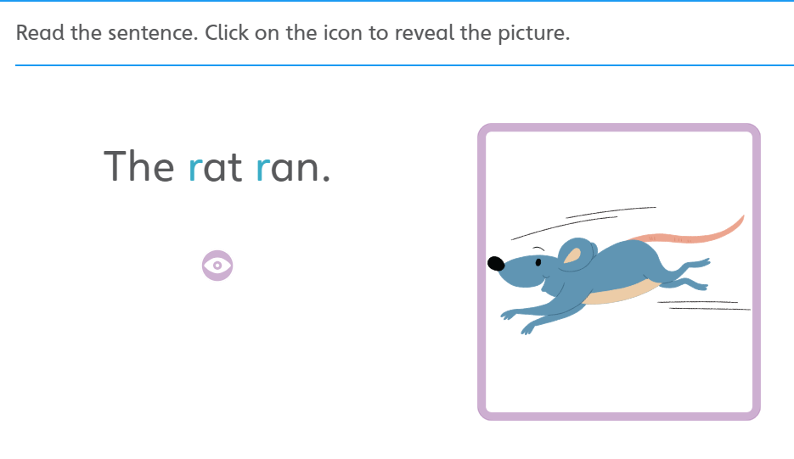
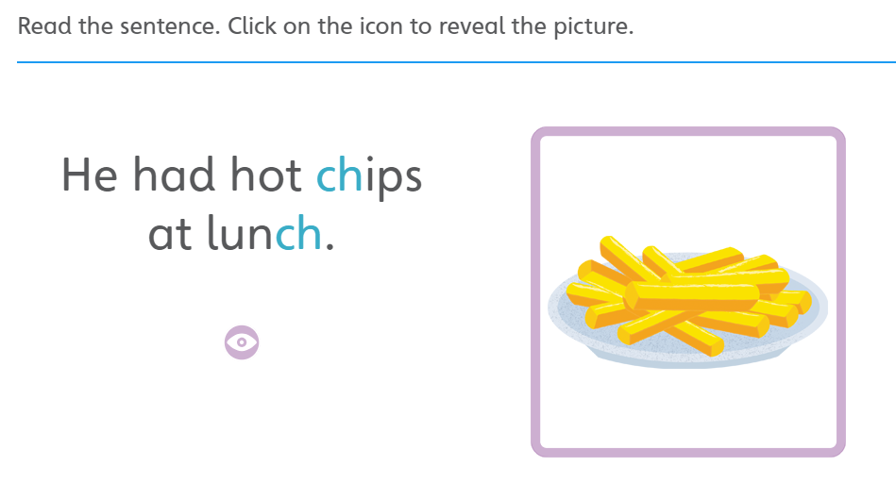
How do we teach phonics?
Notes:
In the beginning of Reception, we learn to read words and then captions, phrases and sentences. As children learn more of the code of our language we are able to build more complex sentences for them to read.

Slide 12
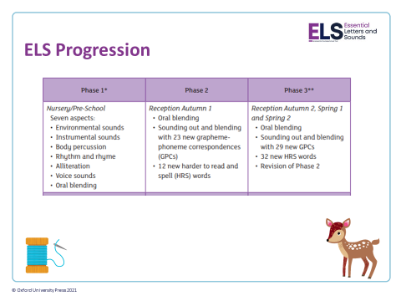
Notes:
In Reception your children will learn all the single letter sounds and begin to learn diagraphs and trigraphs.

Slide 13
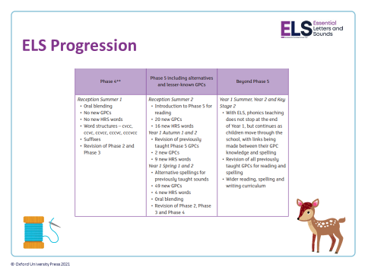

Slide 14
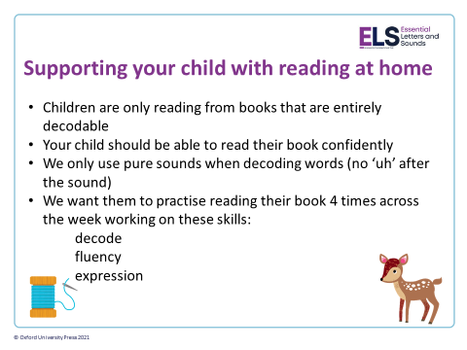
Decodable- they should recognise every sound in the book.
When we read individually with your child we read the next set, which should be more challenging, in order to assess them. If they have learnt the next set of sounds we will move them on.
We do whole class teaching every day so all children are getting taught and exposed to the new sounds.
Individual intervention is given if needed.
Notes:
We want children to only have success when learning to read
Decode – explain this meaning
Fluency – recognising the sound for spelling within the word and blending fluently
expression – model this for the children in school, when reading at home we want children to start to think about expression and intonation. For example, if someone is asking a question let’s get the children to make their voices sound like they are asking a question.

Slide 15
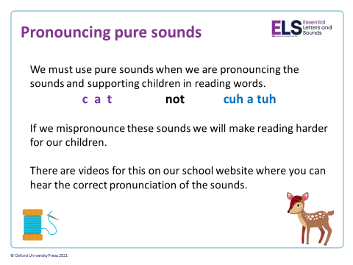
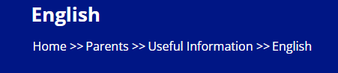
https://www.stpeters.herts.sch.uk/english-1/ Click on this link to watch the pronunciation videos. You can find these on the school website:

Slide 16
How to support your child with reading:
Consider which stage your child is at.
It is essential not to push your child on until they have grasped the earlier set of skills- this can lead to reluctant and demotivated readers.
Phase 1/oral blending skills are essential skills that children must have before they can read words independently.
Consider the time of day and length of time.
Promote reading for enjoyment. Comprehension and discussion is so important.

Slide 17

How to support your child with reading:
Stage 1: Oral blending
Option 1:
You read the story and pick a word on each page to orally sound out and blend for your child. You then say the whole word. Ask the children to repeat back with you.
Adult: c-a-t, cat, let’s do that together
Adult and child: c-a-t cat.
Option 2:
You sound out the word- they blend it together
Adult: c-a-t?
Child: cat
Point to the letters when doing this to help them make the connection between the phoneme and grapheme.
* If your child is still grasping oral blending play lots of games to promote this. (see website)
Try using robot arms and blending hands as this may help your child.

Slide 18
How to support your child with reading:
Stage 2: Blending for reading
Option 1:
You read the story and pick an easy CVC word for your child to try and sound out. They may be able to recognise the sounds and say them but need support to blend.
Child: c-a-t tap?at?
Adult: Let’s try that together.
Adult and child repeat together: c-a-t
Adult: cat.
Option 2:
Your child recognises the sounds and can blend them together independently.
Please note if your child has just learnt to blend you may need to build up the amount of words/pages you expect them to read. This can vary depending on the book. A couple of pages is plenty at this stage. It is better to do small amounts every day to be getting regular practise at this skill.
Option 3:
Once your child is confidently blending all words in a book we can encourage them to sound out in their head and say the whole word aloud. This technique will develop their fluency. This is also a good opportunity to talk about and explore expression.

Slide 19

Digraph/trigraph spotting:
I had fish and chips for my dinner.
The goat and the sheep are on the farm.
It is too dark at night.

Slide 20
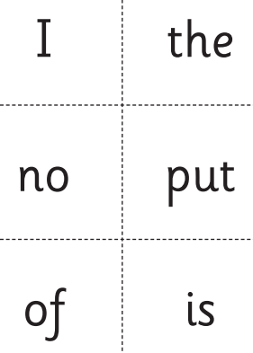
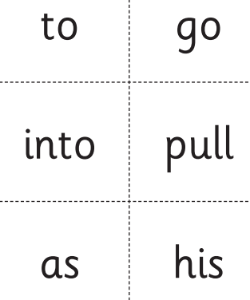
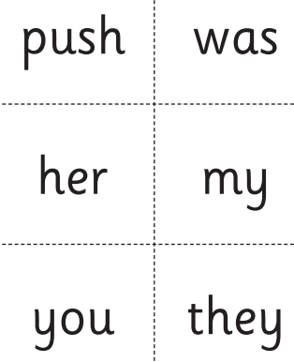
Harder to read and spell word examples:
Notes:
When reading we do not want the children to sound these out. They need to learn to recognise them by sight.
If your child does not recognise them, that is ok, we can tell them what the word is.
Tips: Once your child has read the book a few times, try going back over and see if they can spot any HTRS words in the book.

Slide 21
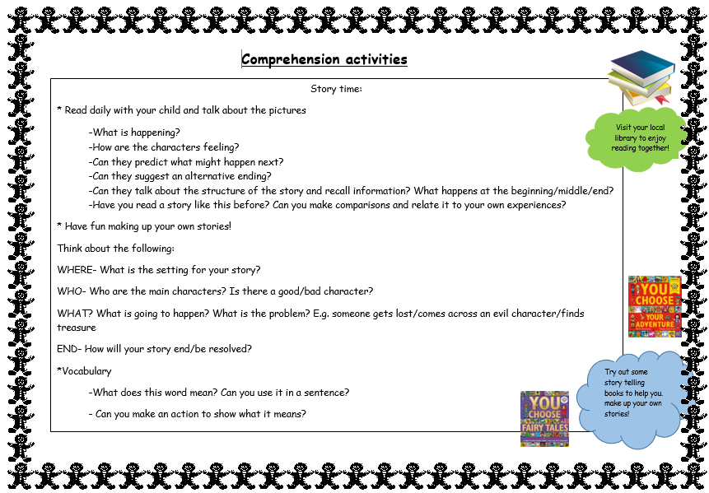
Comprehension:

Slide 22
Other tips:
When reading story books involve your child- can they spot any harder to read and spell words? Can they spot any of the digraphs we have learnt? Or are there any words in the book they could have a go at reading? (This makes them feel very grown up!)
Comprehension
Little and often. Aim for 3-4 times a week.
Please write in the reading record book.
Keep it fun- remember to talk about the story, characters, make predictions, suggest alternative endings.
Use the environment to promote reading: signs, shops, menu’s.

Slide 23
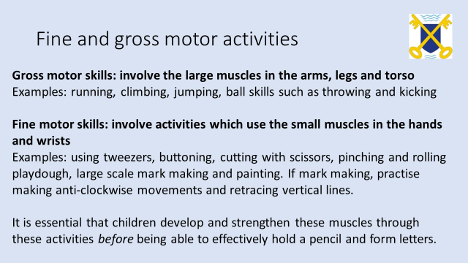
Notes:
Preparation for writing

Slide 24
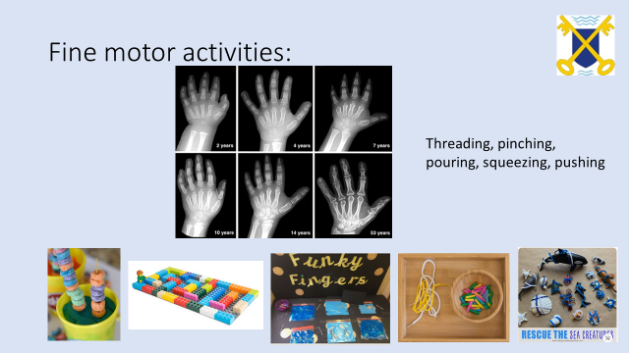

Slide 25
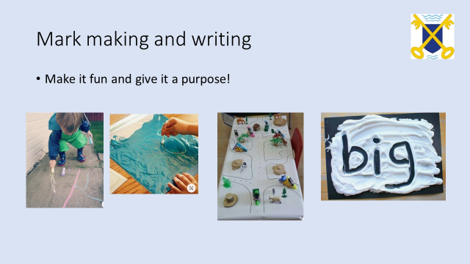

Slide 26
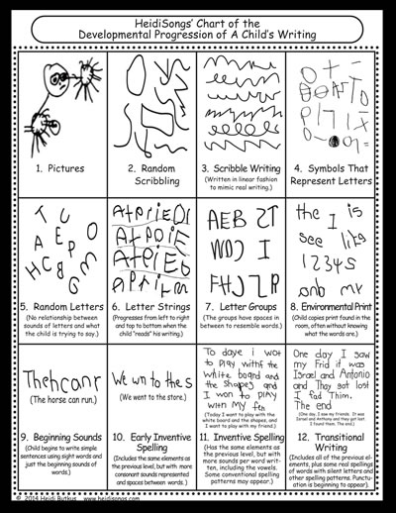
Example of progression of writing:
Notes:
It is important to consider where your child is developmentally.
They may need more mark making experience- creating simple representations using lines and circles
Check out ‘Top Tip’s for fine motor ideas and Pinterest

Slide 27


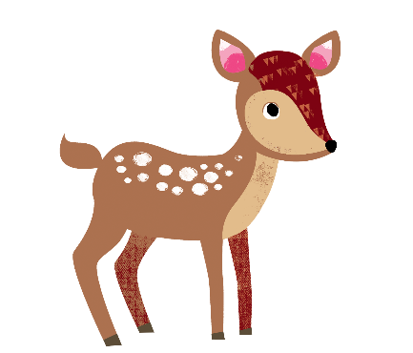

Supporting your child with writing at home
You can use the spelling sequence with your children at home to support them with their writing.
Let’s try this with the word: rain
We also practise saying our sentences before we write them to make sure we write the sentence we have planned and to ensure it makes sense!
© Oxford University Press 2021
Notes:
Use the spelling sequence to model rain
Say the word – warm it up – stretch the word – robot talk the word – blend the word – count the sounds within the word – say the word

Slide 28
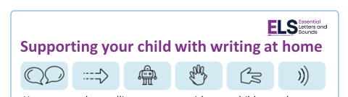
Segmenting and writing longer words
As your child develops their segmenting skills they will begin trying to spell longer words.
These words do not have to be spelt accurately, as long as they are phonetically plausible.
unicorn
planet
Notes:
It is important to build confidence and give lots of praise as writing is hard work!

Slide 29
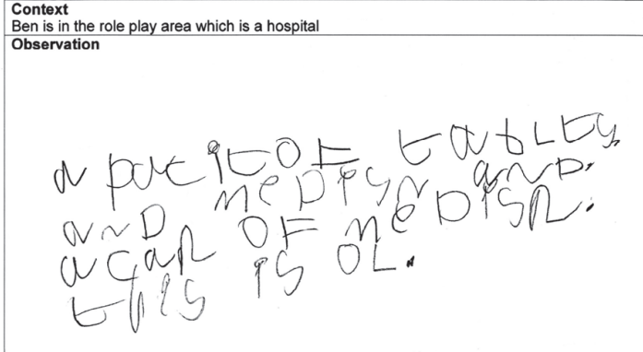
Examples of writing in EYFS:
A packet of tablets and medicine and a can of medicine. This is all.

Slide 30
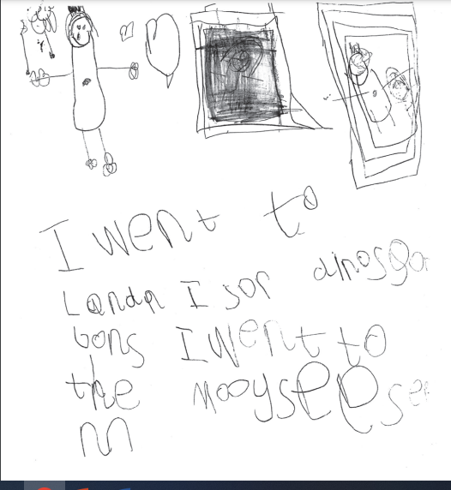
I went to London I saw dinosaur bones I went to the museum.

Slide 31
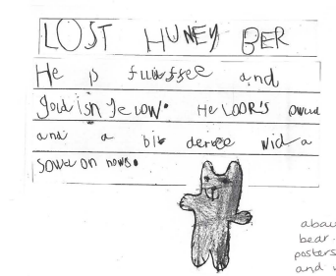
LOST Honey Bear
He is fluffy and goldish yellow. He looks old and a bit dirty with a sewn on nose.

Slide 32
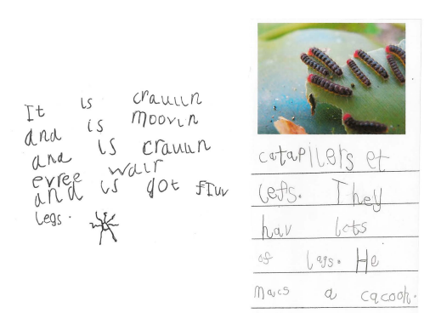
Caterpillars eat leaves. They have lots of legs. He makes a cocoon.
It is crawling and is moving and is crawling everywhere and it’s got five legs.

Slide 33
Resources for parents
Sound cards-amazon https://www.amazon.co.uk/Essential-Letters-Sounds-Grapheme-Reception/dp/1382032919/ref=asc_df_1382032919/?tag=googshopuk-21&linkCode=df0&hvadid=606577469952&hvpos=&hvnetw=g&hvrand=6034962102326414368&hvpone=&hvptwo=&hvqmt=&hvdev=c&hvdvcmdl=&hvlocint=&hvlocphy=1006512&hvtargid=pla-1793108378283&psc=1&th=1&psc=1
Phase 3 and Phase 5 phonics sheet
Harder to Read and Spell word overview
Comprehension sheet
‘Top Tips’ page on the website
Website- ELS videos

Slide 34
Questions?

