Slide 1

2024

Slide 2
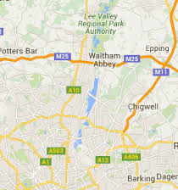
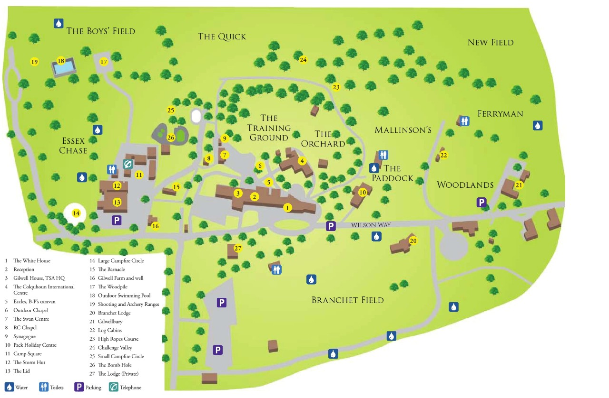
LOCATION

Slide 3
STaffing
Miss honour
Mrs Mitchell fox
Mrs Hornsby
Mrs Young

Slide 4
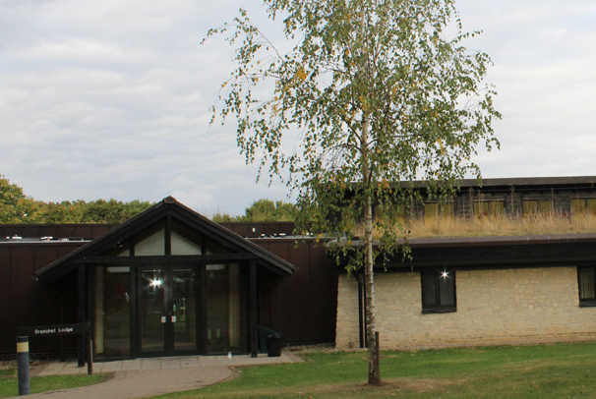
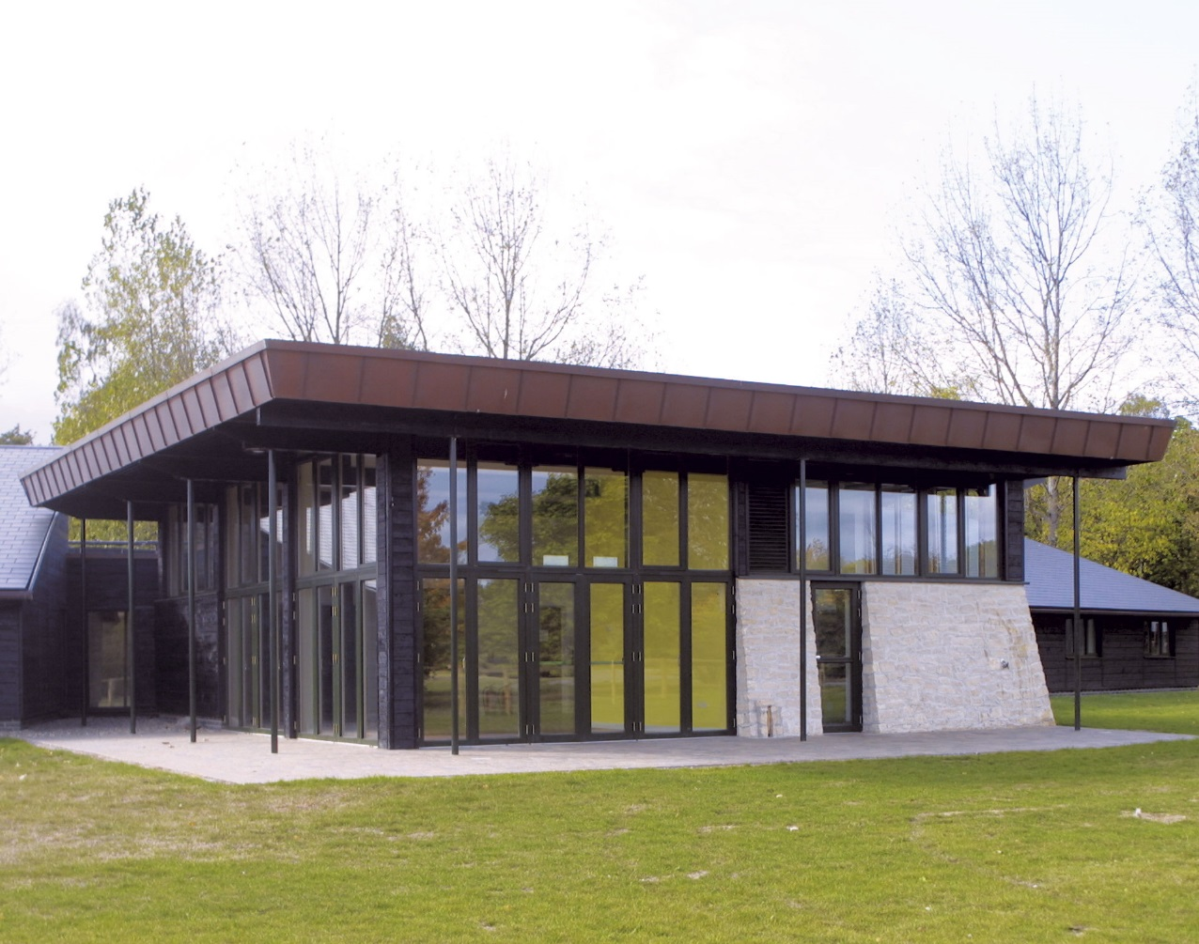
Accommodation- bRANCHET LODGE

Slide 5
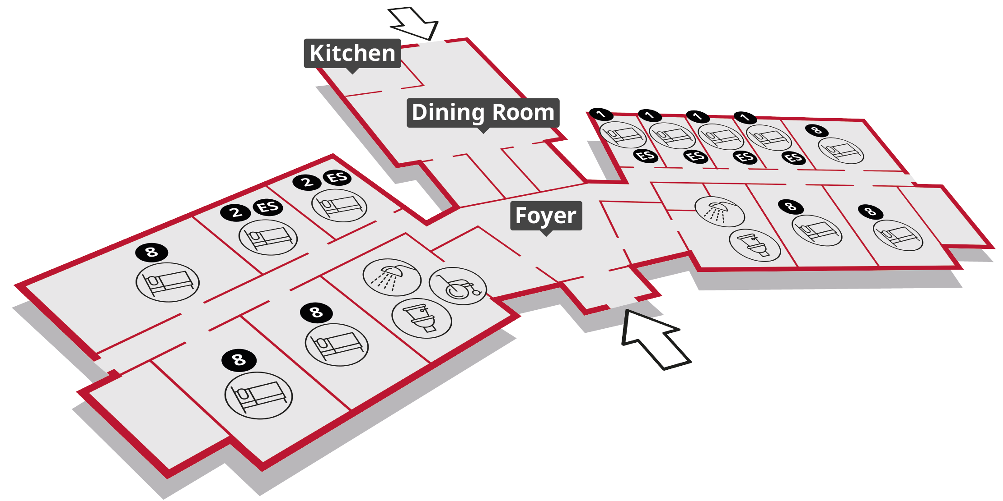

Slide 6
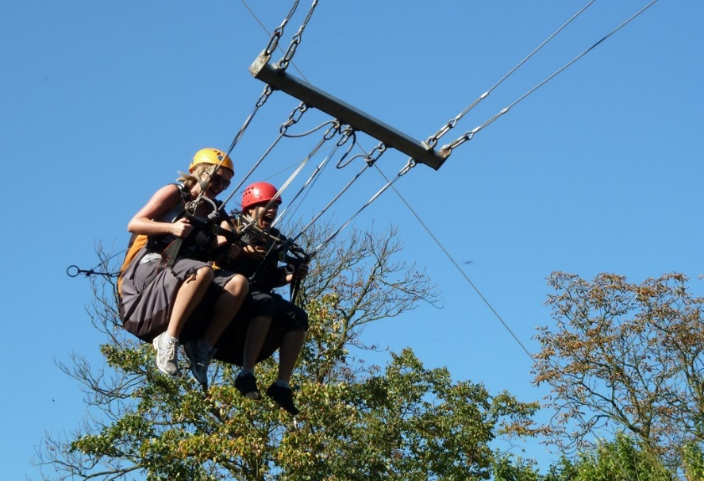
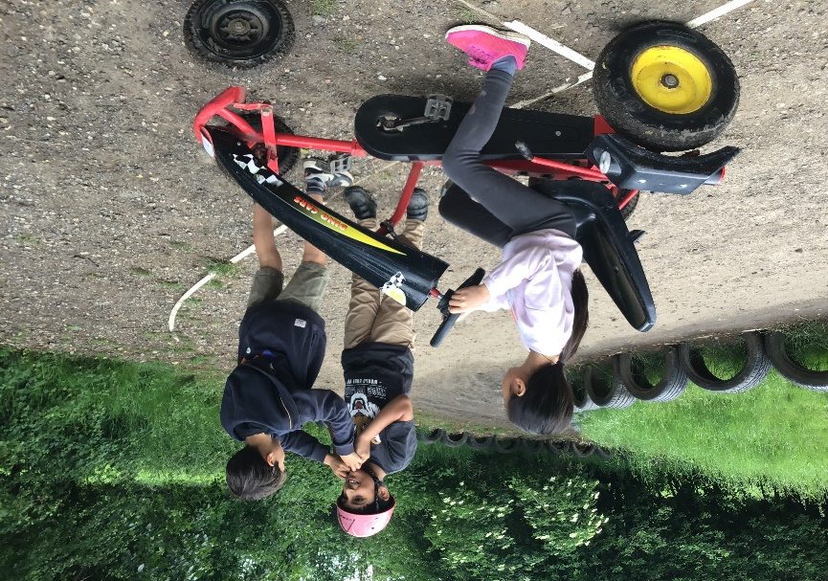
Activities
3G Swing Jacobs Ladder Archery Backwoods Cooking
Shelter Building Crate Stacking Team Building Orienteering

Slide 7

Itinerary
Wednesday | Thursday | Friday
 | 08.00 – 09.00 Breakfast | 08.00 – 09.00 Breakfast
 | 09.15 – 10.45 Activity 3 | 09.15 – 10.45 Activity 7
11.30 – 12.30 Meet and Greet | 11.00 – 12.30 Activity 4 | 11.00 – 12.30 Activity 8
12.30 – 13.00 lunch | 12.45 – 13.15 Lunch | 12.45 – 13.15 Lunch
13.30 – 15.00 Activity 1 | 13.15 – 15.00 Activity 5 | 13:30 Depart
15.15 – 16.45 Activity 2 | 15.15 – 16.45 Activity 6
17.30 – 18.15 Dinner | 17.30 – 18.15 Dinner
19.00 – 20.30 Outdoor Games | 19.00 – 21.00 Campfire

Slide 8


Lights Out!
9.30pm

Slide 9
Food
All meals provided during our stay
Packed lunch needed for first day
Served in Dining room
Kitchen facilities in lodge
DIETARY Requirements catered

Slide 10
Medicines
Prescribed medicines
Over the counter medicines
Issues with sleeping/ eating/bedwetting
Complete medical form and return to school asap

Slide 11
What to bring!
Kit list in pack
Small backpack
Avoid jeans
Lots of light layers
Water bottle, hat and suncream!
Black bag/carriers bags
No Camera or electronic devices
No Sweets/snacks
Packed lunch for day of arrival
POCKET MONEY (£5)

Slide 12
Arrival and departure
Wednesday 1st May– arrive at school at 10am. Coach will depart at 10:30am.
Friday 3rd May– Coach will leave Gilwell at 1:30pm arrival back at school at 2:30pm – we will update school with eta when we leave Gilwell

Slide 13
Questions
Full cost of the trip to be paid by Friday 26th April

