Slide 1

Understanding and Supporting your child with Anxiety
What is anxiety?
When is anxiety a problem?
Spotting the signs
Supporting your child

Slide 2

What is Mental Health?

Slide 3
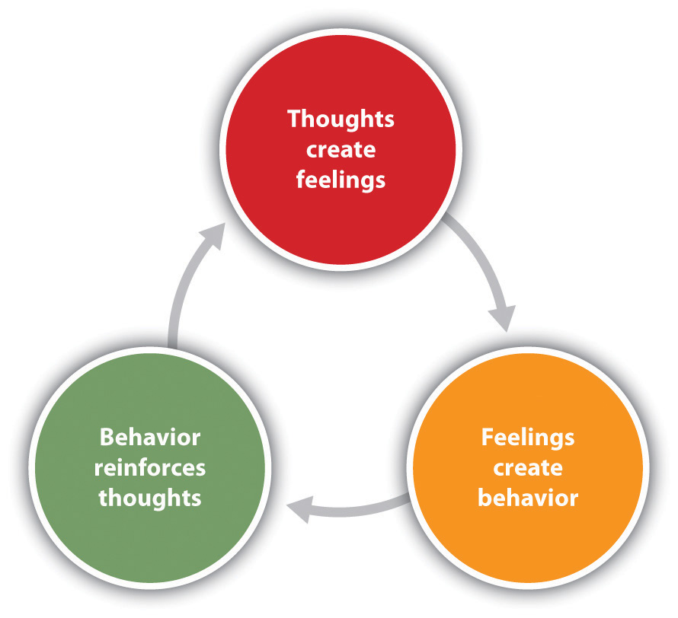
Feelings, Thoughts and Behaviour

Slide 4

What is Anxiety
There are 4 parts:
Physical
Emotional
Thoughts
Behaviour

Slide 5
When is Anxiety a Problem?
Anxiety is normal – when is it problematic?
Is it developmentally normal, eg. separation anxiety?
What are the triggers?

Slide 6
Risk Factors
Environment – parental anxiety / environmental factors, eg. school, separation, moving house, friendships, poor family relationships
Genetic factors
Temperament and personality
Notes:
.

Slide 7
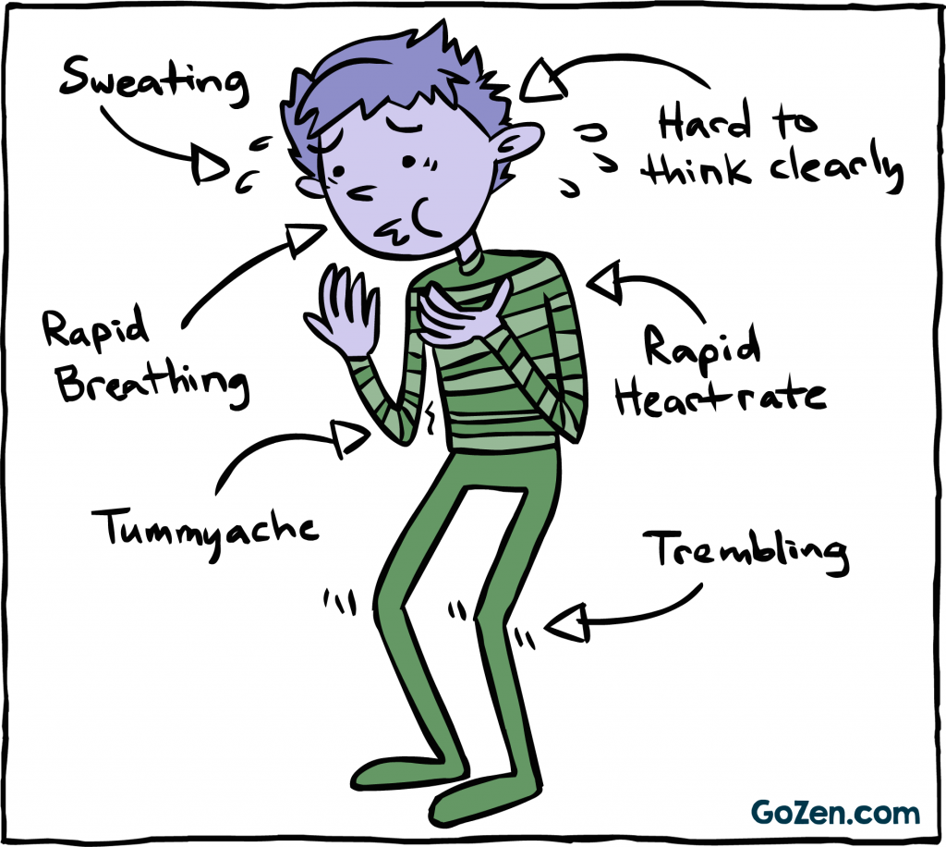
What does Anxiety Look Like?

Slide 8
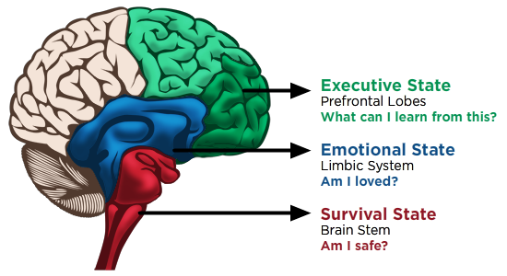
Feelings, Thoughts and Behaviour

Slide 9
How to Spot the Signs in your Child
Unexplained physical symptoms, eg. tummy ache, headaches, fatigue
Excessively clingy
Reluctant to try new or existing social situations
Asking questions about things that have or might have happened – imagining the worst
Crying
Anger, restlessness, irritability
Difficulty in sleeping
Overly Perfectionist

Slide 10
Supporting your Child
Starts with you!
Listen / be calm / reassure
Encourage discussion about feelings
Help your child to identify & recognise their feelings
Break down the worries, one by one and take one step at a time
Ensure that all parents/carers are consistent
Be aware of your own anxiety and how you respond to stress

Slide 11
Help your child to rate their worries
Look at a simple scale from 1 to 10 or use a smiley face chart to enable your child to rate their worries
Remember – anxiety is a continuum – anxious feelings will pass
Make sure that your child can talk to you and/or another appropriate adult
Encourage resilience – give your child the tools to help themselves
Role model
Rehearse and prepare

Slide 12
Simple strategies for supporting your child
Sleep
Exercise
Good diet
Reduce technology
Read stories / talk / listen to CD’s
Spend quality time with your child – have fun
Relaxation / Mindfulness / Breathing
If you are very concerned talk to your child’s teacher and/or the GP

Slide 13

Wellbeing
Connect
Give
Be active
Keep learning
Take notice

Slide 14
Resources
www.headspace.com/kids
www.healthforkids.co.uk
www.minded.org.uk
www.hpft.nhs.uk/wellbeing-service
www.itsgoodtotalk.org.uk
Young Minds – parent line 0800 802 5544
Books
Relaxation tapes
Fiddle toys / Sensory toys
Breathing exercises
Yoga
Mindfulness

Slide 15
FAMILY SUPPORT SERVICES
Partnership Development Manager/Director of Vista St Albans CIC – Jo Maher
Tel: 07939 111152 Office: 01727 855134
Email: vistastalbans@gmail.com
www.vistastalbans.org.uk

